Slide 1
Ebay/e-commerce site
Under Guidance of Mrs. Vaishali Sonanis Mam.
BY KAVALI VENKATA SAI SRI KARTHIK

Slide 2
Introduction :
eBay is one of the world’s largest online marketplaces, founded in 1995.
It allows buyers and sellers to connect globally through actions and fixed – price sales.

Slide 3
Members of Team
KAVALI VENKATA SAI SRI KARTHIK – TEST LEAD

Slide 4
Responsibilities
Structured all modules for better organization.
Designed, reviewed and optimized all test cases.
Executed all test cases thoroughly.
Created a detailed defect report and tracked issues until closure.

Slide 5
Overview
What is EBAY?
Ebay is a leading e-commerce platform where individuals and businesses buy and sell products worldwide.
it offers categories like electronics, fashion, collectibles, and vehicles to home goods.
Provides buyer and seller protection, ensuring safe and reliable payments through system.

Slide 6
Modules
Module 1 : Sign in page
Checked all the functionalities on Sign in page which included personal info as email ,
password.
Module 2 : sign up page
Checked all the functionalities in the sign up page and it contains both personal and business type of creating accounts.
Module 3 : home page
Checked all the functionalities on home page which included item details, Quantity, Add to cart button, product info,grid,list button.
Notes:
Module 1: Signn in page
Checked all the functionalities on Sign in page which included personal info as email
address, password
Module 2: Women page
Checked all the functionalities on Women page which included item details, Quantity, Filters,compare button,Add to cart button,product info,grid,list button
Module 3: Tshirt page
Checked all the functionalities on T-Shirt page which included item details, Quantity, Filters,compare button,Add to cart button,product info,grid,list button
Module 4: All Buttons and Drop Down Arrow :
team checked if all the buttons and drop down arrows of different fields are functioning properly or not

Slide 7
Module 4 : cart
checked if all the buttons in the cart are working or not like adding the quantity of the product, removing items from the cart.
Module 5 : payment
Checked all options of payment are working as expected and ensuring smooth transcation of the customer.
Module 6 : product page
Check that all the features in the product page working as expected like add to cart, buy, add to watchlist.
Module 7 : all headers And footers
Show all valid details on header and footer like ,logo of shop, contact us, sign in, add to cart, all info about site(terms and conditions, about us, contact us)

Slide 8
Module 8 : shop by category
checked if all the products are displayed as per the category.
Module 9 : search
checked search option in the website and ensuring all the products are displaying
as per search and reported defects in the search module.

Slide 9
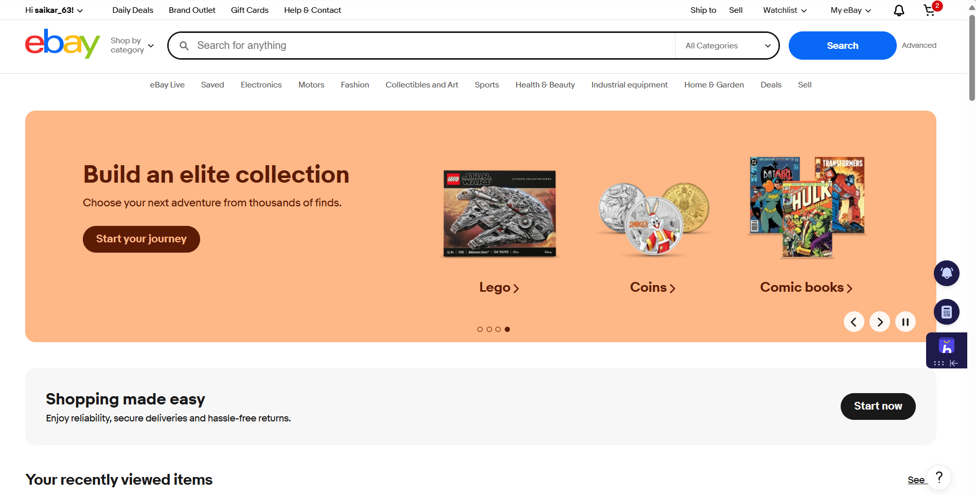

Slide 10
Defects
While running a testcase at certain point some fields are not working as it is expected which is nothing but a defect, so I have created a Defect report on those defects.

Slide 11
Defect identifier :-Def_login_003
Defect summary :- In the registration page email is not verified before proceeding to further steps.
Ø Test Id :- EB‑003
Ø Test case name :- SHOULD BE ABLE TO TAKE valid EMAIL
Ø Module name :- registration module
Ø Reproducible :-
Ø Severity :- medium
Ø Priority :- medium
Ø Raised by :- kavali Venkata sai sri karthik
Ø Assigned to :- developer Team lead
Ø Date of assignment :- 16/08/2025
Ø Status :- pending
Ø Snap shots :-
Ø Fixed by :- developer
Ø Date of fixing :-

Slide 12
Defect identifier :-Def_login_004
Defect summary :- In the registration page in the first name field it should accept only characters but it is accepting everything.
Ø Test Id :- EB_004
Ø Test case name :- first name should accept only characters
Ø Module name :- registration module
Ø Reproducible :-
Ø Severity :- medium
Ø Priority :- medium
Ø Raised by :- kavali Venkata sai sri karthik
Ø Assigned to :- developer Team lead
Ø Date of assignment :- 16/08/2025
Ø Status :- pending
Ø Snap shots :-
Ø Fixed by :- developer
Ø Date of fixing :-

Slide 13
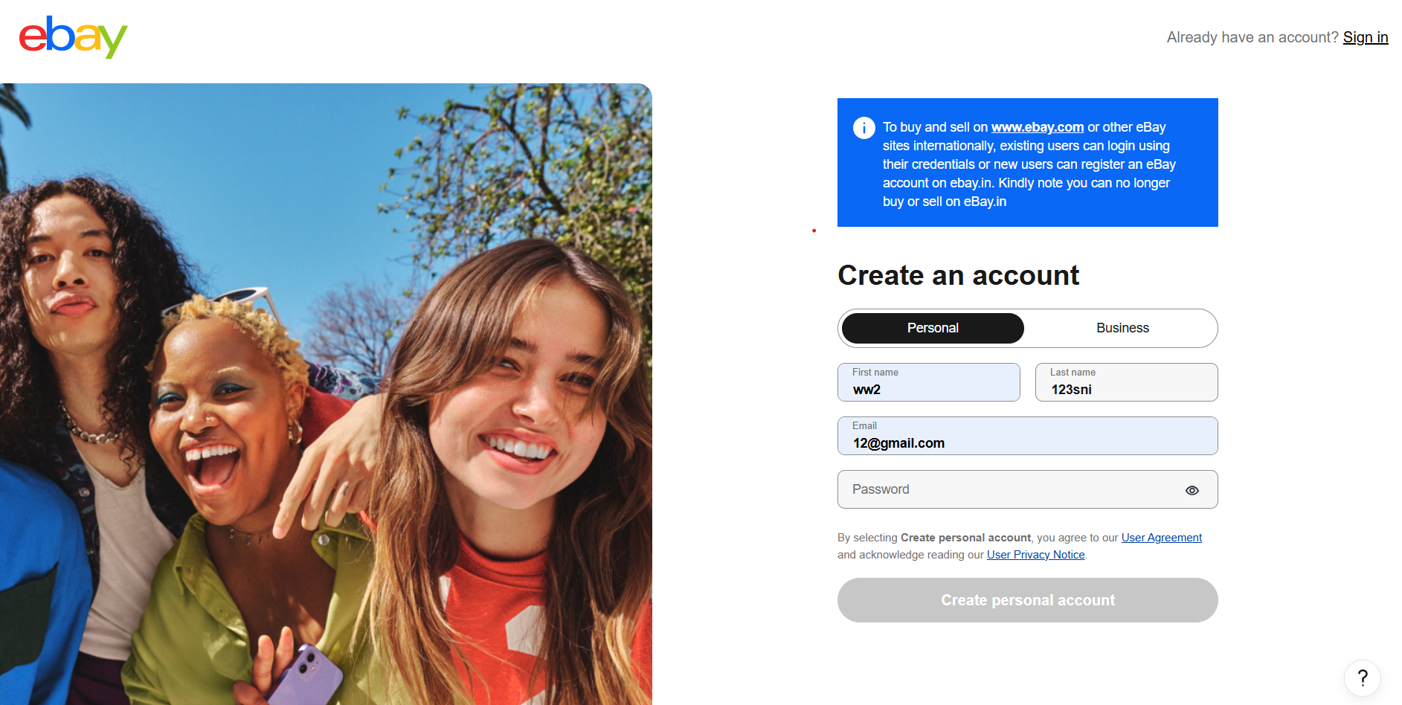

Slide 14
Challenges
If you run automated scripts too fast, eBay may flag you as a bot and block your account or IP.
While testing big website which contains huge data we faced some challenges about:
inorder to test one module I have to start from scratch ebay has flows like login, product search, cart, payement…ect. Covering all flows with automation alone becomes challenging.
if you run automated scripts too fast, ebay may flag you as a bot and may block your account.
Every time products are changing new products are added and some are removed during this process It sometimes be challenging to do automation tasks.

Slide 15
Experience
Because of lot of communication And discussion with our mentor vishali madam it helps me to write taste case in easy way.
I feel exited to work for this project and learn lot of new things during the process and gained hands on experience by doing this project.
Using automation scripts and using frameworks like testng make easier and challenging for handling a large scale projects like ebay.
Manual testing needs strong observation and in that testers needs to apply all possibilities in test cases.

Slide 16
Thank You!!!
Vaishali Mam For Guiding Us through out the Project.

